Slide 1
OBJECT ORIENTED PROGRAMMING CONCEPTS USING JAVA (CA101B)
Ms. Sonam jain

Slide 2
Java OOP(Object Oriented Programming) Concepts
Object-Oriented Programming (OOP) is a programming paradigm based on the concept of objects that contain data (fields) and behavior (methods). It focuses on designing software that closely represents real-world entities. It is used to:
Improves code reusability
Enhances maintainability and scalability
Makes programs easier to understand and manage
Closely models real-world entities

Slide 3
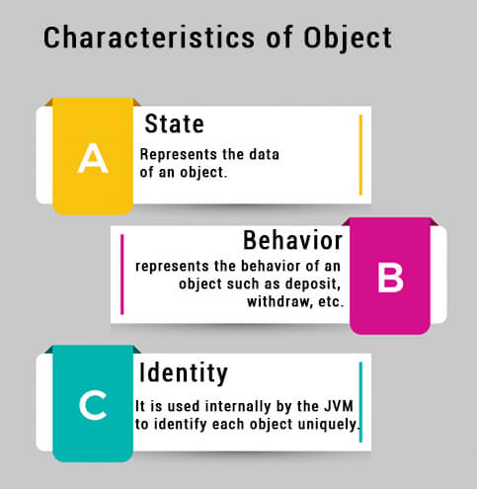
All objects have three essential features:

Slide 4
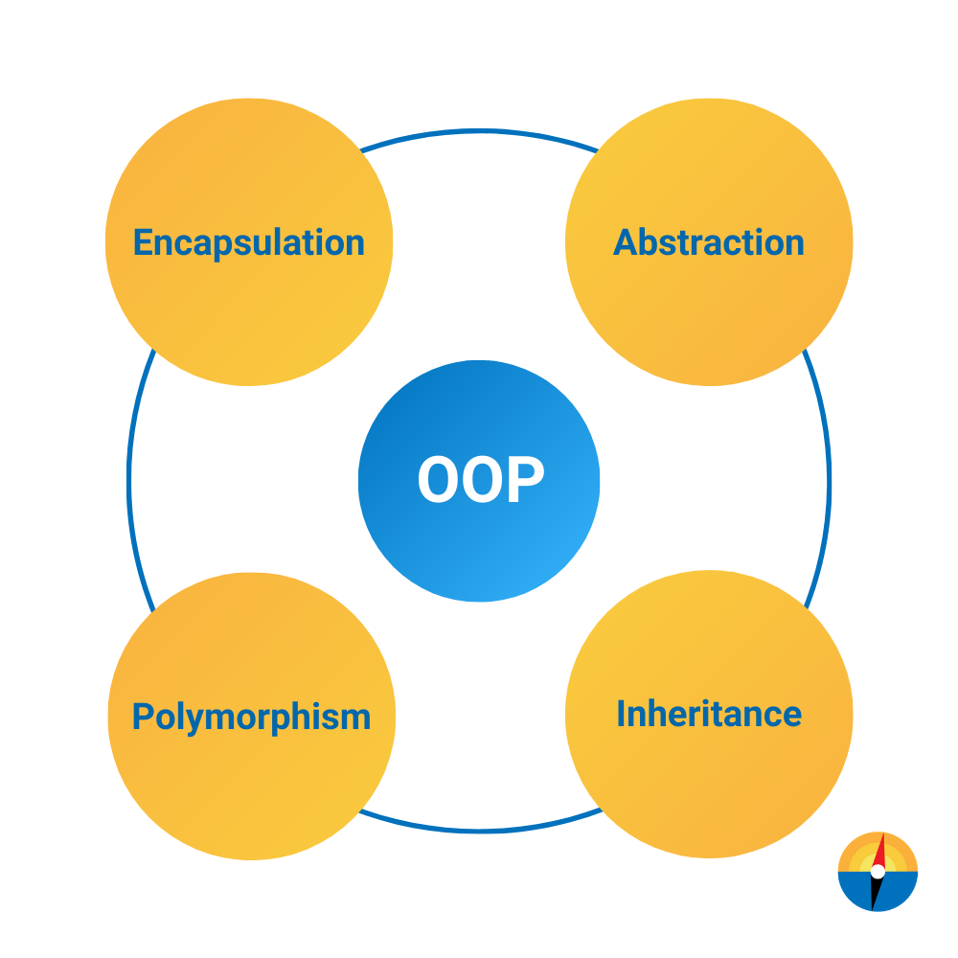
OOP Concepts in Java

Slide 5
Class and Object
A class is a blueprint from which individual objects are created.
In Java, everything is related to classes and objects.
Each class has its methods and attributes that can be accessed and manipulated through the objects.
Properties of Java Classes
A class does not take any byte of memory.
A class is just like a real-world entity, but it is not a real-world entity. It's a blueprint where we specify the functionalities.
A class contains mainly two things: Methods and Data Members.
A class can also be a nested class.
Classes follow all of the rules of OOPs such as inheritance, encapsulation, abstraction, etc.

Slide 6
Creating (Declaring) a Java Class
To create (declare) a class, you need to use access modifiers followed by class keyword and class_name.
Syntax to create a Java class
Use the below syntax to create (declare) class in Java:
access_modifier class class_name{
data members;
constructors;
methods;
...;
}

Slide 7
Example of a Java Class
// Creating a Java class
class Dog {
// Declaring and initializing the attributes
String breed;
int age;
String color;
// methods to set breed, age, and color of the dog
public void setBreed(String breed) {
this.breed = breed;
}
public void setAge(int age) {
this.age = age;
}
public void setColor(String color) {
this.color = color;
}
// method to print all three values
public void printDetails() {
System.out.println("Dog detials:");
System.out.println(this.breed);
System.out.println(this.age);
System.out.println(this.color);
}
}

Slide 8
What are Java Objects?
An object is a variable of the type class,
it is a basic component of an object-oriented programming system.
A class has the methods and data members (attributes), these methods and data members are accessed through an object.
Thus, an object is an instance of a class.
Creating (Declaring) a Java Object
There are three steps when creating an object from a class −
Declaration − A variable declaration with a variable name with an object type.
Instantiation − The 'new' keyword is used to create the object.
Initialization − The 'new' keyword is followed by a call to a constructor. This call initializes the new object.

Slide 9
Syntax to Create a Java Object
Consider the below syntax to create an object of the class in Java:
Class_name object_name = new Class_name([parameters]);

Slide 10
Example
class Dog {
// Declaring and initializing the attributes
String breed;
int age;
String color;
// methods to set breed, age, and color of the dog
public void setBreed(String breed) {
this.breed = breed;
}
public void setAge(int age) {
this.age = age;
}
public void setColor(String color) {
this.color = color;
}
// method to print all three values
public void printDetails() {
System.out.println("Dog detials:");

Slide 11
Example
System.out.println(this.breed);
System.out.println(this.age);
System.out.println(this.color);
}
}
public class Main {
public static void main(String[] args) {
// Creating an object of the class Dog
Dog obj = new Dog();
// setting the attributes
obj.setBreed("Golden Retriever");
obj.setAge(2);
obj.setColor("Golden");
// Printing values
obj.printDetails();
}
}

Slide 12
Accessing Instance Variables and Methods
/* First create an object */
ObjectReference = new Constructor();
/* Now call a variable as follows */
ObjectReference.variableName;
/* Now you can call a class method as follows */
ObjectReference.MethodName();

Slide 13
Scanner class /Input from User
In Java, the Scanner class is present in the java.util package is used to obtain input for primitive types like int, double, etc., and strings.
class Demo
{
public static void main(String[] args) {
Scanner sc = new Scanner(System.in);
System.out.println("Enter your name:");
String name = sc.nextLine();
System.out.println("Hello, " + name + " Welcome to the GeeksforGeeks.");
}
}

Slide 14
System is a built-in class in Java. It has 3 important objects:
System.out → for printing output (screen).
System.err → for error messages.
System.in → for taking input (keyboard).

Slide 15
.
Method | Description
nextBoolean() | Used for reading Boolean value
nextByte() | Used for reading Byte value
nextDouble() | Used for reading Double value
nextFloat() | Used for reading Float value
nextInt() | Used for reading Int value
nextLine() | Used for reading Line value
nextLong() | Used for reading Long value
nextShort() | Used for reading Short value

Slide 16
Constructors
Characteristics of Constructors:
Same Name as the Class
No Return Type
Automatically Called on Object Creation
Used to Set Initial Values for Object Attributes

Slide 17
Example
// Java Program to demonstrate
// Constructor usage
import java.io.*;
// Driver Class
class Demo {
// Constructor
Demo()
{
System.out.println("Constructor Called");
}
// main function
public static void main(String[] args)
{
Demo d= new Demo();
}
}

Slide 18
.
Why Do We Need Constructors in Java
Constructors play a very important role, it ensures that an object is properly initialized before use.
What happens when we don't use constructors:
Without constructors:
Objects might have undefined or default values.
Extra initialization methods would be required.
Risk of improper object state

Slide 19
Types of Constructors in Java
There are three types of constructors in Java are mentioned below:
Default Constructor
Parameterized Constructor
Copy Constructor

Slide 20
Default Constructor
A constructor that has no parameters is known as default constructor.
default constructor is invisible.
if we write a constructor with no arguments, the compiler does not create a default constructor.
Implicit Default Constructor: If no constructor is defined in a class, the Java compiler automatically provides a default constructor.
Explicit Default Constructor: If we define a constructor that takes no parameters, it's called an explicit default constructor. This constructor replaces the one the compiler would normally create automatically.
(Default constructor provides the default values to the object like 0, null, false etc. depending on the type.)

Slide 21
Parameterized Constructor in Java
A constructor that has parameters is known as parameterized constructor
If we want to initialize fields of the class with our own values, then use a parameterized constructor.

Slide 22
Example
class Student {
// Data members
String name;
int age;
// Parameterized constructor
Student(String studentName, int studentAge) {
name = studentName;
age = studentAge;
}
// Method to display student details
void display() {
System.out.println("Name: " + name + ", Age: " + age);
}
// Main method
public static void main(String[] args) {
// Creating objects using parameterized constructor
Student s1 = new Student("Rahul", 20);
Student s2 = new Student("Anita", 22);
// Display details
s1.display();
s2.display();
}
}

Slide 23
Copy Constructor in Java
Unlike other constructors copy constructor is passed with another object which copies the data available from the passed object to the newly created object.

Slide 24
Example
class Student {
// Data members
String name;
int age;
// Parameterized constructor
Student(String studentName, int studentAge) {
name = studentName;
age = studentAge;
}
// Method to display student details
void display() {
System.out.println("Name: " + name + ", Age: " + age);
}

Slide 25
.
// Main method
public static void main(String[] args) {
// Creating objects using parameterized constructor
Student s1 = new Student("Rahul", 20);
Student s2 = new Student("Anita", 22);
// Display details
s1.display();
s2.display();
}
}

Slide 26
Copy Constructor
class Student {
String name;
int age;
// Parameterized constructor
Student(String n, int a) {
name = n;
age = a;
}
// Copy constructor
Student(Student s) {
name = s.name;
age = s.age;
}

Slide 27
.
void display() {
System.out.println("Name: " + name + ", Age: " + age);
}
public static void main(String[] args) {
Student s1 = new Student("Rahul", 20); // normal object creation
Student s2 = new Student(s1); // copy constructor used
s1.display();
s2.display();
}
}

Slide 28
Inheritance
Java Inheritance is a fundamental concept in OOP(Object-Oriented Programming).
It is the mechanism in Java by which one class is allowed to inherit the features(fields and methods) of another class.

Slide 29
example
class Animal {
void eat() {
System.out.println("This animal eats food.");
}
}
// Child class (inherits Animal)
class Dog extends Animal {
void bark() {
System.out.println("The dog barks.");
}
}

Slide 30
example
public class Main {
public static void main(String[] args) {
// Create object of Dog class
Dog d = new Dog();
// Dog can use both its own method and inherited method
d.eat(); // from Animal class
d.bark(); // from Dog class
}
}

Slide 31
Why Use Inheritance in Java?
Code Reusability
Method Overriding
Abstraction
Key Terminologies Used in Java Inheritance
Class
Super Class/Parent Class
Sub Class/Child Class
Extends Keyword
(The extends keyword establishes an "is-a" relationship between the child class and the parent class. This allows a child class to have all the behavior of the parent class.)

Slide 32
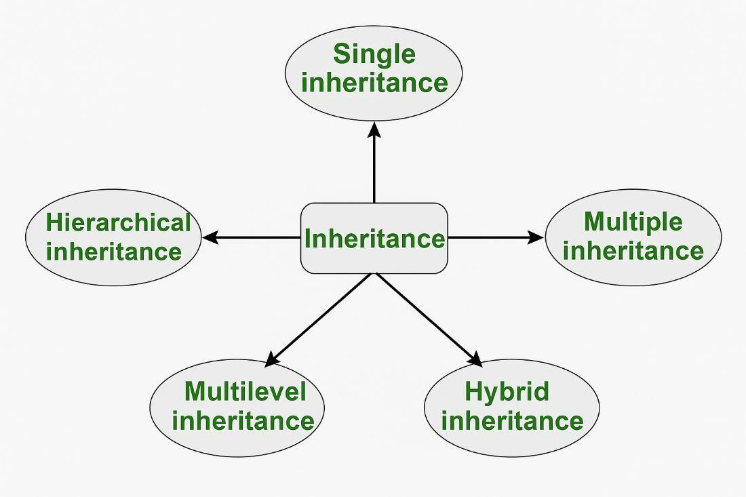
Types of Inheritance in Java

Slide 33
Single Inheritance
class Person {
void displayInfo() {
System.out.println("I am a person.");
}
}
// Child class (inherits from Person)
class Student extends Person {
void displayStudent() {
System.out.println("I am a student.");
}
}
public class Main {
public static void main(String[] args) {
// Create object of Student
Student s = new Student();
// Child class can access both parent and its own methods
s.displayInfo(); // from Person class
s.displayStudent(); // from Student class
}
}

Slide 34
Multilevel Inheritance
// Parent class
class Animal {
void eat() {
System.out.println("This animal eats food.");
}
}
// Child class of Animal
class Dog extends Animal {
void bark() {
System.out.println("The dog barks.");
}
}
// Child class of Dog (Grandchild of Animal)
class Puppy extends Dog {
void weep() {
System.out.println("The puppy is weeping.");
}

Slide 35
.
}
public class Main {
public static void main(String[] args) {
// Create object of Puppy class
Puppy p = new Puppy();
// Puppy can access methods from all levels
p.eat(); // from Animal
p.bark(); // from Dog
p.weep(); // from Puppy
}
}

Slide 36
Hierarchical Inheritance
// Parent class
class Animal {
void eat() {
System.out.println("This animal eats food.");
}
}
// First child class
class Dog extends Animal {
void bark() {
System.out.println("The dog barks.");
}
}
// Second child class
class Cat extends Animal {
void meow() {

Slide 37
.
System.out.println("The cat meows.");
}
}
public class Main {
public static void main(String[] args) {
// Dog object
Dog d = new Dog();
d.eat(); // inherited from Animal
d.bark(); // own method
// Cat object
Cat c = new Cat();
c.eat(); // inherited from Animal
c.meow(); // own method
}
}

Slide 38
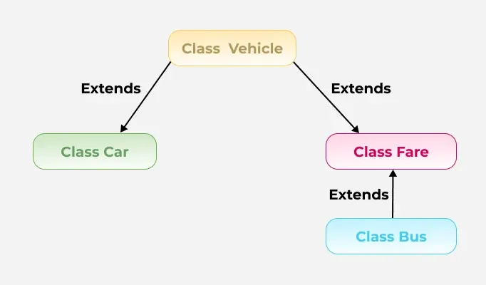
Hybrid Inheritance

Slide 39
Super Keyword
The super keyword in Java is a reference variable that is used to refer to the parent class when we are working with objects.
Characteristics of Super Keyword in Java
Calling the Parent Class Constructor
Accessing Parent Class Methods
Accessing Parent Class Fields
First Statement in a Constructor
Cannot be used in Static Context
Not Always Required We know that the super keyword is used to call the methods from the parent class. If a method is not overridden in the subclass, then calling it without the super keyword will invoke the parent class's implementation.

Slide 40
Use of super with Variables
This scenario occurs when a derived class and base class have the same data members. In that case, there is a possibility of ambiguity for the JVM
class Vehicle {
int maxSpeed = 120;
}
// sub class Car extending vehicle
class Car extends Vehicle {
int maxSpeed = 180;
void display()
{
// print maxSpeed from the vehicle class
// using super
System.out.println("Maximum Speed: "
+ super.maxSpeed);
}
}

Slide 41
Use of super with Variables
// Driver Program
class Test {
public static void main(String[] args)
{
Car small = new Car();
small.display();
}
}

Slide 42
Use of super with Methods
Whenever a parent and child class have the same-named methods then to resolve ambiguity we use the super keyword.
class Person {
void message()
{
System.out.println("This is person class\n");
}
}
// Subclass Student
class Student extends Person {
void message()
{
System.out.println("This is student class");
}
// Note that display() is
// only in Student class
void display()
{

Slide 43
.
// will invoke or call current
// class message() method
message();
// will invoke or call parent
// class message() method
super.message();
}
}
// Driver Program
class Test {
public static void main(String args[])
{
Student s = new Student();
// calling display() of Student
s.display();
}
}

Slide 44
Use of super with Constructors
The super keyword can also be used to access the parent class constructor.
One more important thing is that ‘super’ can call both parametric as well as non-parametric constructors depending on the situation.
// superclass Person
class Person {
Person()
{
System.out.println("Person class Constructor");
}
}
//subclass Student extending the Person class
class Student extends Person {
Student()
{
// invoke or call parent class constructor
super();
System.out.println("Student class Constructor");
}
}

Slide 45
.
// invoke or call parent class constructor
super();
System.out.println("Student class Constructor");
}
}
// Driver Program
class Test {
public static void main(String[] args)
{
Student s = new Student();
}
}

Slide 46
Final Member
it means “cannot be changed” or “cannot be overridden/modified”, depending on where it’s used.
Uses of final Keyword
The final keyword can be applied to:
Variables
Methods
Classes

Slide 47
Final Variable → Value cannot be changed
final int x = 10;
x = 20; (error)
Final Method → Cannot be overridden by a subclass
class Animal {
final void sound() {
System.out.println("Animal makes a sound");
}
}
class Dog extends Animal { (Error)
void sound() {
System.out.println("Dog barks");
}
}

Slide 48
Final Class → Cannot be inherited
final class Vehicle {
void run() {
System.out.println("Vehicle is running");
}
}
// Error: cannot subclass final class
class Car extends Vehicle {
void run() {
System.out.println("Car is running");
}
}

Slide 49
2. Final Methods Cannot Be Overridden
class Parent{
// Can't be overridden
final void show(){
}
}
class Child extends Parent{
// This would produce error
void show() {}
}

Slide 50
Static Member
The static keyword in Java means that the member belongs to the class, not to any specific object. This means:
You don’t need to create an object to access it.
All objects of that class share the same static member.
Use of Static keyword
Variables (static variables)
Methods (static methods)
Blocks (static blocks)
Nested classes (static nested classes)

Slide 51
Static Variable (Class Variable)
class Student {
int rollNo;
String name;
static String college = "ABC College"; // static variable
Student(int r, String n) {
rollNo = r;
name = n;
}
void display() {
System.out.println(rollNo + " " + name + " " + college);
}
}
public class Test {
public static void main(String[] args) {
Student s1 = new Student(1, "Riya");
Student s2 = new Student(2, "Aman");
s1.display();
s2.display();
}
}

Slide 52
Static Method
class Demo {
static void showMessage() {
System.out.println("Hello from static method!");
}
void display() {
System.out.println("This is a non-static method");
}
}
public class Test {
public static void main(String[] args) {
Demo.showMessage(); // No object needed
Demo d = new Demo();
d.display(); // Needs object
}
}

Slide 53
Static Block
class Example {
static {
System.out.println("Static block executed before main");
}
public static void main(String[] args) {
System.out.println("Main method executed");
}
}

Slide 54
3. Static Methods
class Parent {
static void display() {
System.out.println("Static method in Parent");
}
}
class Child extends Parent {
static void display() {
System.out.println("Static method in Child");
}
}
public class Test {
public static void main(String[] args) {
Parent p = new Child();
p.display(); // Output: Static method in Parent
}
}

Slide 55
4. Private Methods
Private methods cannot be overridden because they are not visible to subclasses.
A subclass method with the same name is treated as a new, independent method, unrelated to the parent class.

Slide 56
Example
class Parent{
private void display(){
System.out.println("Parent private method");
}
}
class Child extends Parent{
void display(){
// This is a new method, not overriding
System.out.println("Child method");
}
}
public class GFG{
public static void main(String[] args){
Child c = new Child();
// Calls Child's method
c.display();
}
}

Slide 57
Polymorphism
The word Polymorphism comes from Greek — “poly” (many) + “morph” (forms). It means one name, many forms.
In Java, polymorphism allows an object to perform different actions based on its actual type, even when the reference type is the same.
(The same method name can behave differently for different objects.)

Slide 58
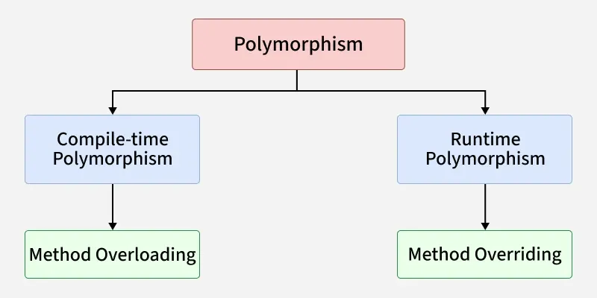
.

Slide 59
1. Compile-Time Polymorphism
Compile-Time Polymorphism in Java is also known as static polymorphism and also known as method overloading. This happens when multiple methods in the same class have the same name but different parameters.

Slide 60
Method Overloading
Method overloading in Java means having multiple methods with the same name in a class, but with different parameters
→ (different number, type, or order of parameters).
For method overloading:
Methods must have the same name
But different parameter lists
Return type may or may not be different
It happens within the same class

Slide 61
Example
class MathOperation {
int add(int a, int b) {
return a + b;
}
int add(int a, int b, int c) {
return a + b + c;
}
double add(double a, double b) {
return a + b;
}
}

Slide 62
Example
public class OverloadExample {
public static void main(String[] args) {
MathOperation m = new MathOperation();
System.out.println("Sum of two int: " + m.add(5, 10));
System.out.println("Sum of three int: " + m.add(5, 10, 15));
System.out.println("Sum of two double: " + m.add(2.5, 3.7));
}
}

Slide 63
Changing Order of Parameters
class Display {
void show(String name, int age) {
System.out.println(name + " is " + age + " years old");
}
void show(int age, String name) {
System.out.println(name + " is " + age + " years old");
}
}
public class Test {
public static void main(String[] args) {
Display d = new Display();
d.show(“aman", 25);
d.show(30, "Riya");
}
}

Slide 64
Runtime Polymorphism
Runtime Polymorphism in Java known as Dynamic Method Dispatch. It is a process in which a function call to the overridden method is resolved at Runtime. This type of polymorphism is achieved by Method Overriding. Method overriding, on the other hand, occurs when a derived class has a definition for one of the member functions of the base class. That base function is said to be overridden.

Slide 65
Method Overriding
Method overriding means defining a method in the child class that has the same name, same parameters, and same return type as a method in its parent class.

Slide 66
.
class Animal {
void sound() {
System.out.println("Animal makes a sound");
}
}
class Dog extends Animal {
@Override
void sound() {
System.out.println("Dog barks");
}
}
public class MethodOverridingExample {
public static void main(String[] args) {
Animal a = new Dog(); // Upcasting
a.sound(); // Calls Dog's version
}
}

Slide 67
.
class Animal {
void sound() {
System.out.println("Animal makes a sound");
}
}
class Dog extends Animal {
@Override
void sound() {
System.out.println("Dog barks");
}
}
class Cat extends Animal {
@Override
void sound() {

Slide 68
.
System.out.println("Cat meows");
}
}
public class Example {
public static void main(String[] args) {
Animal a; // Parent reference
a = new Dog(); // Upcasting to Dog
a.sound(); // Output: Dog barks
a = new Cat(); // Upcasting to Cat
a.sound(); // Output: Cat meows
}
}

Slide 69
Special Cases in Overriding
1. Calling Parent Method Using super
class Parent{
void show(){
System.out.println("Parent's show()");
}
}
class Child extends Parent{
@Override
void show(){

Slide 70
super.show();
System.out.println("Child's show()");
}
}
public class Main{
public static void main(String[] args){
Parent obj = new Child();
obj.show();
}
}

Slide 71
Upcasting
Upcasting means assigning a child class object to a parent class reference.
Parent reference = Child object
It happens automatically in Java (implicit casting).
Because in the inheritance tree, we move upward from child → parent.
Parent obj = new Child();
Upcasting is the base of dynamic method dispatch.

Slide 72
Example
class Animal {
void sound() {
System.out.println("Animal makes sound");
}
}
class Dog extends Animal {
void sound() {
System.out.println("Dog barks");
}
void walk() {
System.out.println("Dog walks");
}
}
class Demo {
public static void main(String[] args) {
Animal a = new Dog(); // Upcasting
a.sound(); // Calls Dog’s sound() → Runtime Polymorphism
// a.walk(); // Not allowed (parent reference can't access child-specific methods)
}
}

Slide 73
Dynamic Method Dispatch
Dynamic Method Dispatch is the runtime process in Java where an overridden method is called based on the object (not the reference type).
It is also called: Runtime Polymorphism Dynamic Binding Late Binding
Java checks the actual object type at runtime.
calls the child’s overridden method, not the parent’s

Slide 74
Constructor Chaining
Constructor Chaining means calling one constructor from another constructor. It helps avoid repeating code and improves reusability.
It happens in two ways:
Within the Same Class → using this()
Between Parent → Child Classes → using super()

Slide 75
Within the Same Class → using this()
class Demo {
Demo() {
System.out.println("Default Constructor");
}
Demo(int x) {
this(); // Calls the default constructor
System.out.println("Parameterized Constructor: " + x);
}
}
class Main {
public static void main(String[] args) {
Demo d = new Demo(10);
}
}

Slide 76
Between Parent → Child Classes → using super()
class Parent {
Parent() {
System.out.println("Parent Constructor");
}
}
class Child extends Parent {
Child() {
super(); // Calls Parent constructor
System.out.println("Child Constructor");
}
}
class Test {
public static void main(String[] args) {
Child c = new Child();
}
}

Slide 77
Encapsulation
Encapsulation in Java is one of the four main pillars of Object-Oriented Programming (OOP) (along with inheritance, polymorphism, and abstraction).
It means binding (or wrapping) data and methods that operate on that data into a single unit — usually a class — and restricting direct access to some of the object’s components.
In Java, encapsulation is achieved by:
Declaring variables as private (so they can’t be accessed directly from outside the class).
Providing public getter and setter methods to access and update the values safely.

Slide 78
.
public int getAge() {
return age;
}
public void setAge(int age) {
if (age > 0) {
this.age = age;
} else {
System.out.println("Invalid age!");
} } }
class Student {
private String name;
private int age;
//Public getter and setter methods
public String getName() {
return name;
}
public void setName(String name) {
this.name = name;
}

Slide 79
.
public class Main {
public static void main(String[] args) {
Student s = new Student();
s.setName("John");
s.setAge(20);
System.out.println("Name: " + s.getName());
System.out.println("Age: " + s.getAge());
}
}

Slide 80
Abstraction
Abstraction means showing only the essential details of an object while hiding unnecessary implementation details. It helps you focus on what an object does instead of how it does it.
Abstraction in Java:
Java achieves abstraction in two main ways:
Abstract Classes (Partial Abstraction)
Interface (100% Abstraction)

Slide 81
Abstract Class
An abstract class in Java is a class that cannot be instantiated (you can’t create objects of it directly). It is used to declare common behavior that subclasses must implement.
It serves as a blueprint for other classes.
Definition:
An abstract class is a class declared with the abstract keyword, and it may contain abstract methods (without body) and/or concrete methods (with body).

Slide 82
.
Key Points
Declared using the abstract keyword.
Cannot be instantiated (no new object of it).
Can have:
Abstract methods (without body)
Concrete methods (with body)
Constructors
Static methods
Variables (static or non-static)
Used to achieve abstraction (typically 0–100%).

Slide 83
Example
abstract class Animal {
// Abstract method (no body)
abstract void sound();
// Non-abstract method
void eat() {
System.out.println("This animal eats food");
}
}
class Dog extends Animal {
void sound() {
System.out.println("Dog barks");
}
}
public class Main {
public static void main(String[] args) {
Animal a = new Dog(); // upcasting
a.sound(); // Dog barks
a.eat(); // This animal eats food
}
}

Slide 84
Can an Abstract Class Have a Constructor?
Yes! An abstract class can have a constructor in Java.
Even though you can’t create an object of an abstract class directly, its constructor is still called when a child class object is created.

Slide 85
Example
abstract class Shape {
int sides;
Shape(int sides) {
this.sides = sides;
System.out.println("Shape constructor: " + sides + " sides");
}
abstract void area();
}

Slide 86
Example
class Rectangle extends Shape {
int length, breadth;
Rectangle(int l, int b) {
super(4); // calling abstract class constructor
this.length = l;
this.breadth = b;
}
void area() {
System.out.println("Area = " + (length * breadth));
}
}
public class Main {
public static void main(String[] args) {
Rectangle r = new Rectangle(5, 3);
r.area();
}
}

Slide 87
Interface
An interface in Java is a completely abstract type that is used to define a contract — a set of methods that a class must implement.
It specifies what a class should do, but not how it should do it.

Slide 88
Example 1
interface Animal {
void sound(); // abstract method
void eat(); // abstract method
}
class Dog implements Animal {
public void sound() {
System.out.println("Dog barks");
}
public void eat() {
System.out.println("Dog eats bones");
}
}
public class Main {
public static void main(String[] args) {
Animal a = new Dog(); // Upcasting
a.sound();
a.eat();
}
}

Slide 89
Example 2
interface TestInterface {
int VALUE = 10; // same as: public static final int VALUE = 10;
}
class Demo implements TestInterface {
void show() {
System.out.println("Value = " + VALUE);
}
}
public class Main {
public static void main(String[] args) {
Demo d = new Demo();
d.show();
// Can also be accessed directly using the interface name
System.out.println(TestInterface.VALUE);
}
}

Slide 90
Access Modifier of Interface Methods
By default, all methods in an interface are:
public
abstract (unless they are default or static)

Slide 91
Multiple Interfaces
interface Printable {
void print();
}
interface Showable {
void show();
}
class Demo implements Printable, Showable {
public void print() {
System.out.println("Printing...");
}

Slide 92
Multiple Interfaces
public void show() {
System.out.println("Showing...");
}
}
public class Main {
public static void main(String[] args) {
Demo obj = new Demo();
obj.print();
obj.show();
}
}

Slide 93
Default and Static Methods
Default methods (with body) — used to add new features without breaking old code.
Static methods — called using the interface name.

Slide 94
Example
interface Vehicle {
default void start() {
System.out.println("Vehicle is starting");
}
static void stop() {
System.out.println("Vehicle is stopping");
}
}
class Car implements Vehicle
{
System.out.println(“Interface Implements"); }
public class Main {
public static void main(String[] args) {
Car c = new Car();
c.start(); // default method
Vehicle.stop(); // static method
}
}

Slide 95
This keyword
this is a reference variable in Java that refers to the current object (the object on which a method or constructor is being called).
Uses of this Keyword
To refer to current object variables
class Student {
int age;
Student(int age) {
this.age = age; // 'this.age' → instance variable
}
}

Slide 96
.
2. To call current class method
class Test {
void show() {
System.out.println("Hello");
}
void display() {
this.show(); // same as show();
}
}
Even if not written, Java adds this. internally.

Slide 97
.
3. To call current class constructor (Constructor Chaining)
class Demo {
Demo() {
System.out.println("Default Constructor");
}
Demo(int x) {
this(); // calling default constructor
System.out.println("Parameterized Constructor");
}
}
4. To pass current object as a parameter
class A {
void show(A obj) {}
void test() {
show(this); // passing current object
}
}

Slide 98
Demonstrate multilevel inheritance using Person → Employee → Manager classes with method overriding and additional properties.

Slide 99
Practice Ques
Write a Java program to demonstrate single inheritance where class Student inherits from class Person. Add methods to display details
Create classes Person and Employee. Use parameterized constructor in both classes. In Employee constructor, use super(name, age) to pass values to Person.
3. Write a program demonstrating Person → Employee → Manager.
Employee uses super to call Person constructor.
Manager overrides a method and calls parent version using super.

